Slide 1


DATATECH LABS.
Data Engineering Course.
Week 3: Data Lakes and Data Warehousing With Modern Data Architectures

Slide 2
Outline: Week 3
Data Lakes Design and Implementation
Understanding data lakes and their benefits
Data lake design patterns and best practices
Data Warehousing and OLAP
Data warehouse architectures and design principles
Dimensional modeling and star schemas
OLAP concepts and cube operations
Modern Data Architectures: Delta Lake and data lakehouse
DATATECH LABS.

Slide 3
Data Lakes Design and Implementation
DATATECH LABS.

Slide 4
Data Lakes
DATATECH LABS.

Slide 5
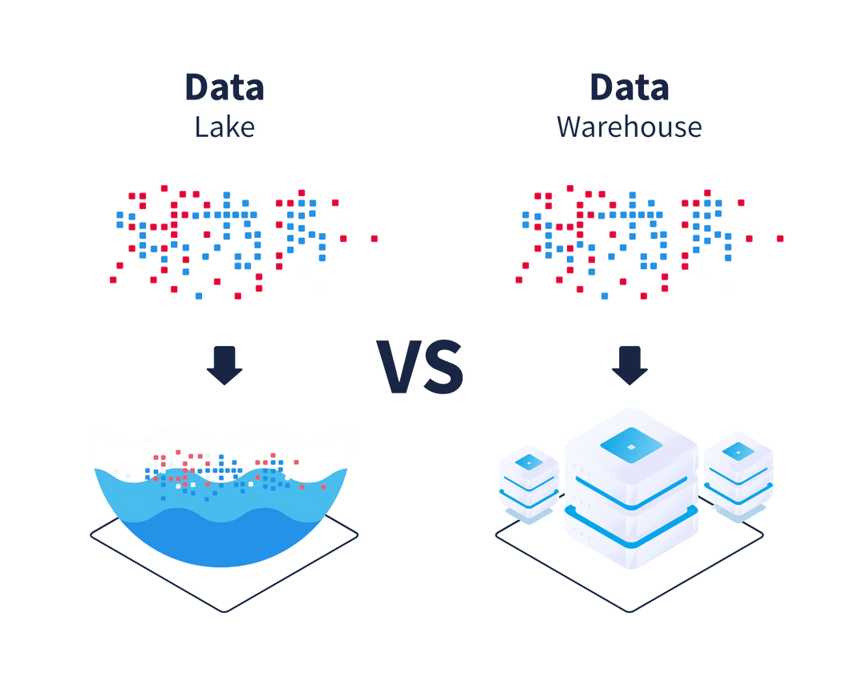
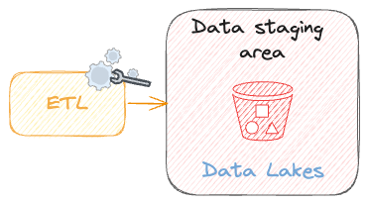
Introduction to Data Lakes
Definition: A centralized repository that allows you to store all your structured and unstructured data at any scale.
Purpose: To store raw data for future processing and analysis.
Imagine the foldering system on your laptop.
DATATECH LABS.

Slide 6
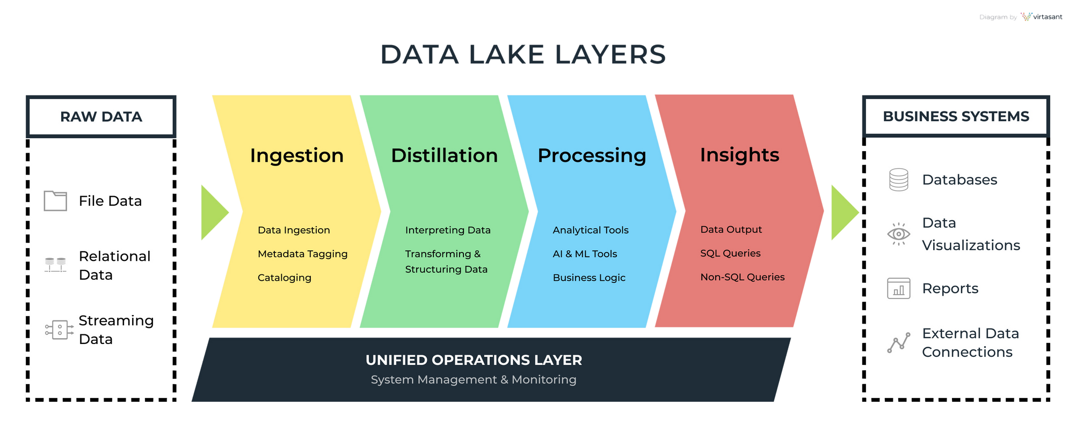
Data Lake Architecture
Data Sources
Ingestion Layer
Storage Layer
Processing Layer
Consumption (Data access) Layer
Data Sources
Ingestion
Storage
Processing
Consumption
DATATECH LABS.

Slide 7
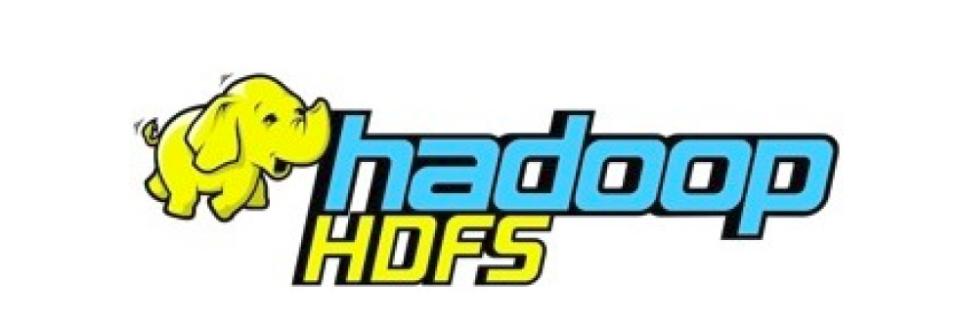
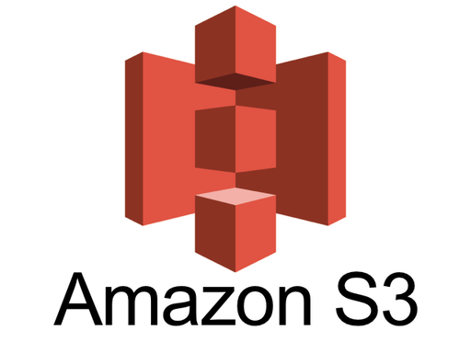
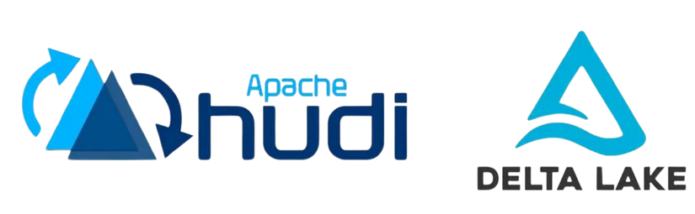
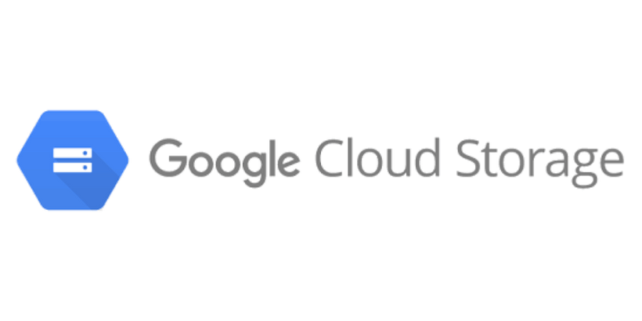
Data Lake Storage Technologies
Hadoop Distributed File System (HDFS)
Cloud object storage (e.g., Amazon S3, Azure Blob Storage, Google Cloud Storage)
Delta Lake
Apache Hudi
Apache Iceberg
DATATECH LABS.

Slide 8
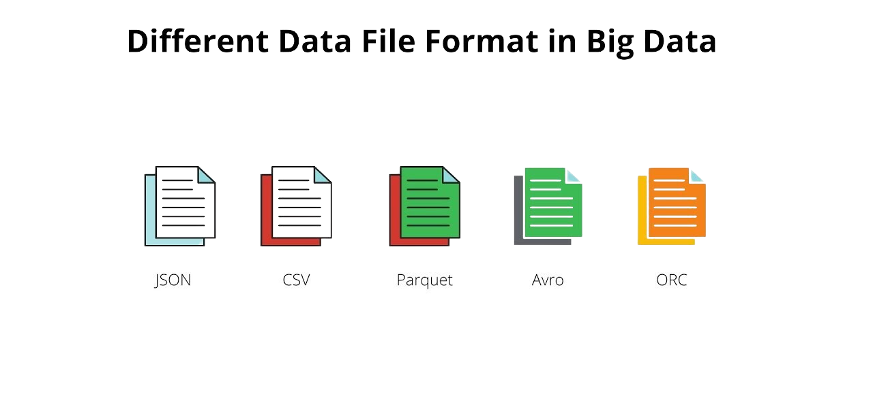
Data Ingestion in Data Lakes
Batch ingestion
Stream ingestion
Change Data Capture (CDC)
Data migration tools
Data Formats in Data Lakes:
CSV
JSON
Avro
Parquet
ORC (Optimized Row Columnar)
DATATECH LABS.

Slide 9
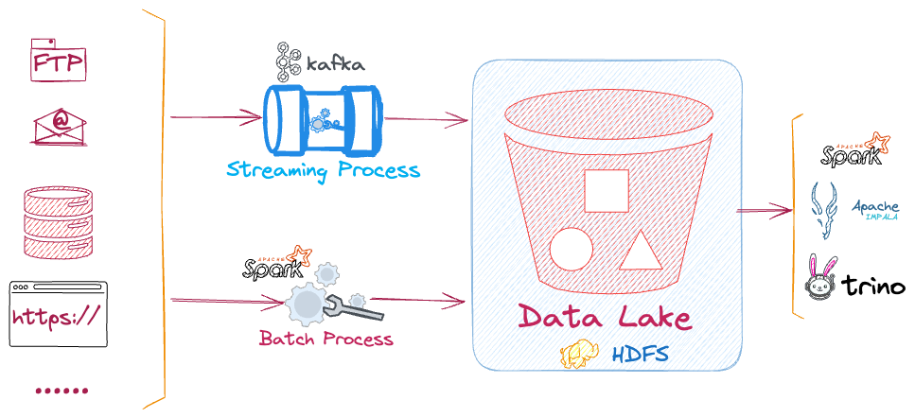
Data Processing in Data Lakes
Batch processing (e.g., Hadoop MapReduce, Spark)
Stream processing (e.g., Spark Streaming, Flink)
Interactive queries (e.g., Presto, Impala)
Machine learning pipelines
DATATECH LABS.

Slide 10

Data Governance in Data Lakes
Metadata management
Data lineage
Access control and security
Data quality management
Data lifecycle management
DATATECH LABS.

Slide 11
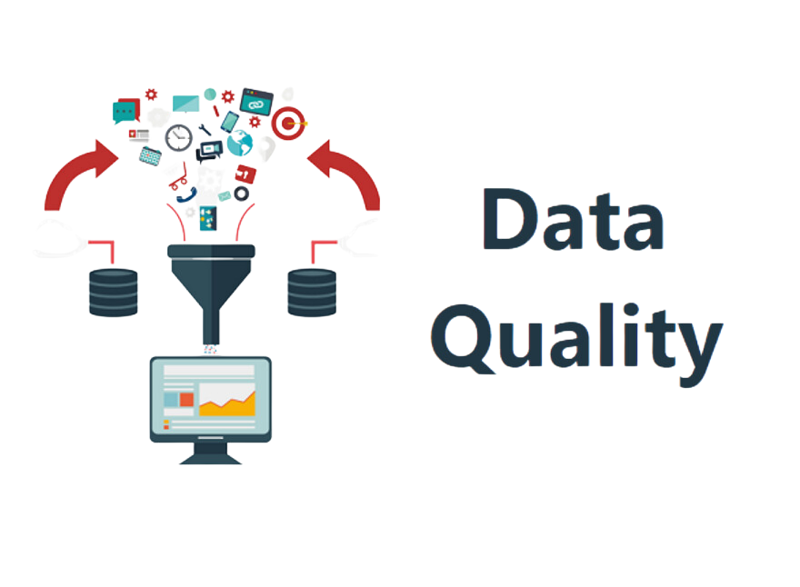
Challenges in Data Lake Implementation
Data swamp prevention
Schema evolution
Data quality issues
Performance optimization
Cost management
DATATECH LABS.

Slide 12
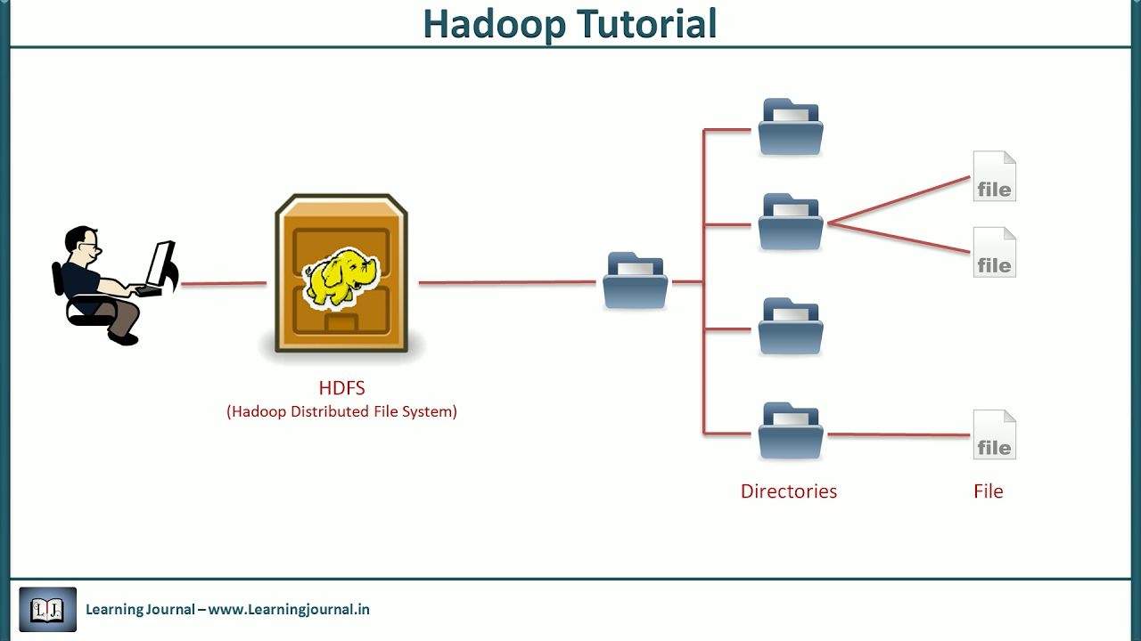
HDFS Data Lake
Overview:
Stands for “Hadoop Distributed File System”.
It is designed to store large volumes of data across many machines and to provide high-throughput access to this data.
Key Features:
Scalability: HDFS can scale to accommodate petabytes of data across thousands of machines.
Fault Tolerance: Data is replicated across multiple nodes, ensuring data availability even in case of hardware failures.
High Throughput: Optimized for large data sets, HDFS provides high-throughput access for big data applications.
DATATECH LABS.

Slide 13

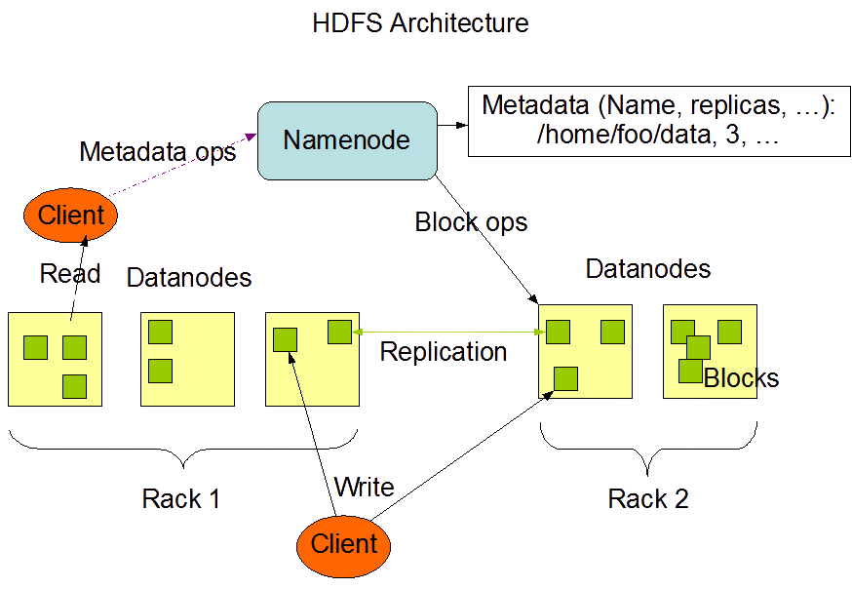
HDFS Architecture and Functionality
Architecture:
NameNode: Manages metadata and regulates access to files.
DataNodes: Store the actual data blocks and perform read/write operations as directed by the NameNode.
Data Storage:
Block Storage: Data is split into large blocks (default 128MB) and distributed across DataNodes.
Replication: Each block is replicated across multiple DataNodes (default is 3 replicas) to ensure fault tolerance.
DATATECH LABS.

Slide 14
HDFS Architecture and Functionality
Data Access:
Write Once, Read Many: Files are written once and read multiple times, optimizing for read-heavy operations typical in big data processing.
Streaming Data Access: HDFS is optimized for sequential read/write access rather than random access.
DATATECH LABS.

Slide 15
Hands-on:
Data Lake: HDFS
DATATECH LABS.

Slide 16
Data Warehousing and Modern Data Architectures
DATATECH LABS.

Slide 17
Data Warehousing
DATATECH LABS.

Slide 18
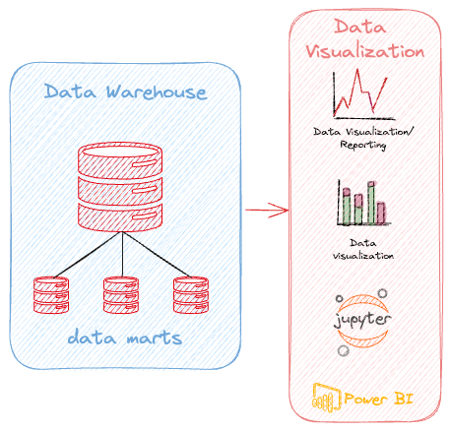
Introduction to Data Warehousing
Definition: A system used for reporting and data analysis, considered a core component of business intelligence
Purpose: To integrate data from multiple sources for complex querying and analysis
DATATECH LABS.

Slide 19
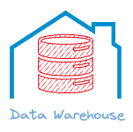
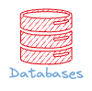
Data Warehouse vs. Operational Database
Aspect | Data Warehouse | Operational Database
Purpose | Analysis and reporting | Day-to-day transactions
Data | Historical, integrated | Current, detailed
Query type | Complex, ad-hoc | Simple, predefined
Users | Analysts, executives | Clerks, managers
Size | Large (TBs to PBs) | Small to medium
DATATECH LABS.

Slide 20
Data Lakes vs. Data Warehouses
Aspect | Data Lake | Data Warehouse
Data structure | Raw, unstructured/semi-structured | Processed, structured
Schema | Schema-on-read | Schema-on-write
Users | Data scientists, analysts | Business analysts
Agility | Highly flexible | Less flexible
Processing | ELT (Extract, Load, Transform) | ETL (Extract, Transform, Load)
DATATECH LABS.

Slide 21
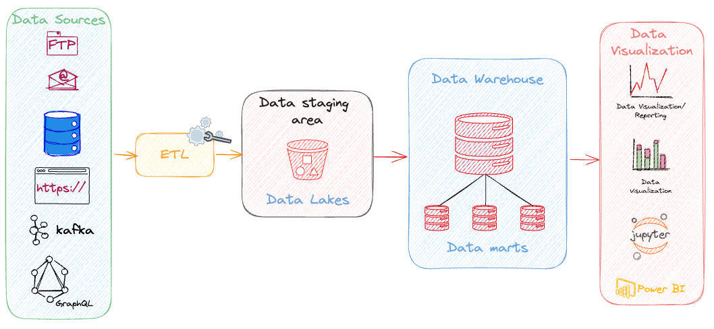
Data Warehouse Architecture
Source systems
ETL Processes
Data staging area
Data warehouse core
Data marts
Data consumption tools
DATATECH LABS.

Slide 22
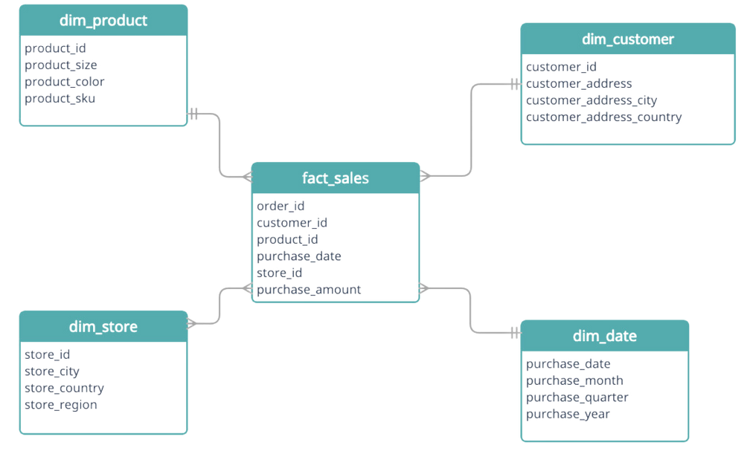
DW Schema Designs: Start & Snowflake
Star Schema: A type of database schema used in data warehousing. It consists of a central fact table connected to multiple dimension tables, resembling a star.
Structure:
Fact Table: Central table containing quantitative data (e.g., sales, revenue).
Dimension Tables: Surrounding tables with descriptive attributes (e.g., time, product, location).
Advantages:
Simpler queries
Faster performance for read operations
Easy to understand and maintain
DATATECH LABS.

Slide 23
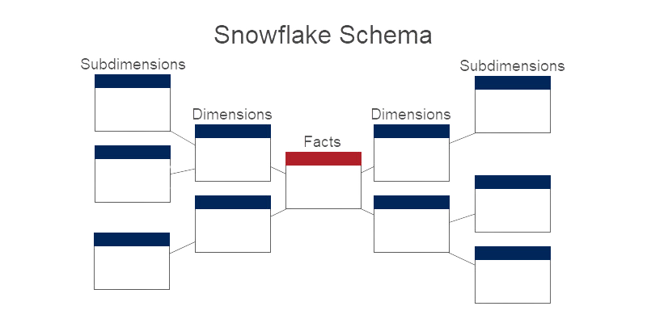
DW Schema Designs: Start & Snowflake
Snowflake Schema: A more normalized version of the star schema where dimension tables are further broken down into related sub-dimension tables.
Structure:
Fact Table: Same as in the star schema.
Normalized Dimension Tables: Hierarchically organized dimension tables.
Advantages:
Reduced data redundancy
More organized and efficient storage
Considerations:
Slightly more complex queries
May have slower query performance
compared to a star schema
DATATECH LABS.

Slide 24
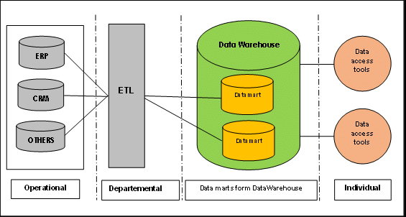
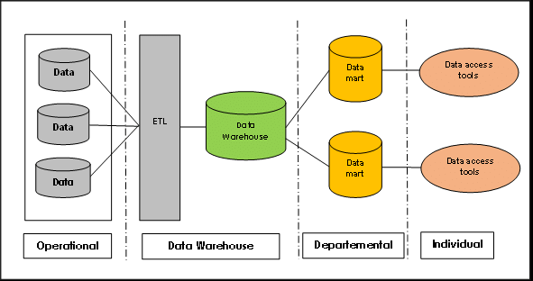
Data Warehouse Implementation Approaches
Inmon approach (Top-down): This approach starts with a corporate data model.
Kimball approach (Bottom-up): This approach starts with recognizing the business process and questions that Data warehouse has to answer.
Hybrid approach
Kimball
Inmon
DATATECH LABS.

Slide 25
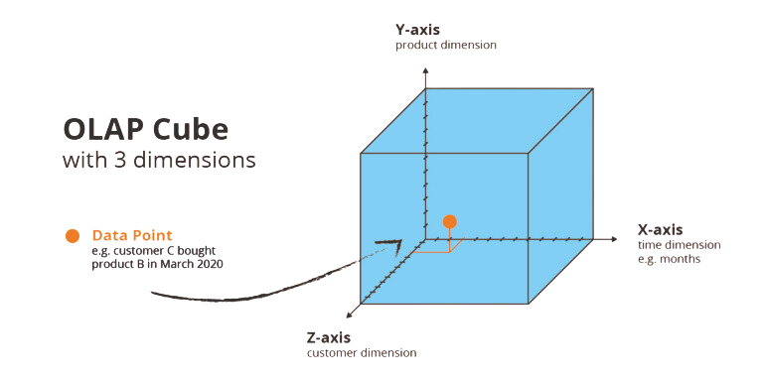
Intro to OLAP (Online Analytical Processing)
Definition: Technology for analyzing multidimensional data from multiple perspectives
Key operations: Slice, dice, drill-down, roll-up, pivot
OLAP Cube:
Dimensions
Measures
Hierarchies
DATATECH LABS.

Slide 26
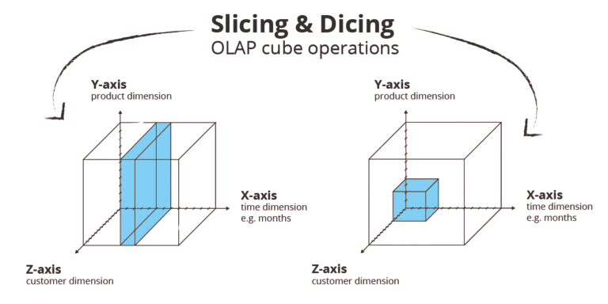
OLAP Cube Slice & dice
Key operations: Slice, dice, drill-down, roll-up, pivot
DATATECH LABS.

Slide 27

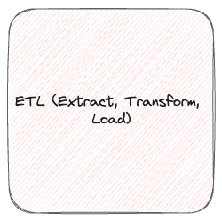
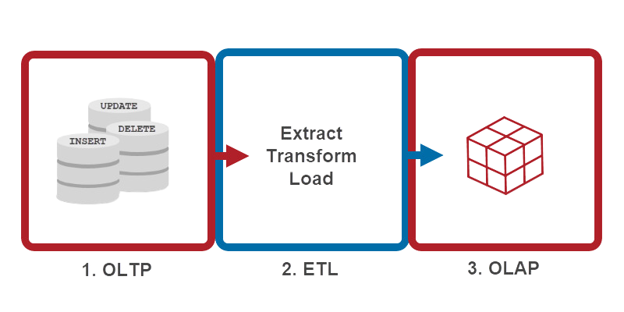
OLTP vs. OLAP
OLTP (Online Transaction Processing)
OLAP (Online Analytical Processing)
Transactional
Analytical
Aspect | OLAP | OLTP
Purpose | Analysis and reporting | Transaction processing
Data updates | Periodic, batch updates | Continuous updates
Queries | Complex, ad-hoc | Simple, standardized
Data view | Multidimensional | Flat relational
Data volume | Large | Moderate
DATATECH LABS.

Slide 28
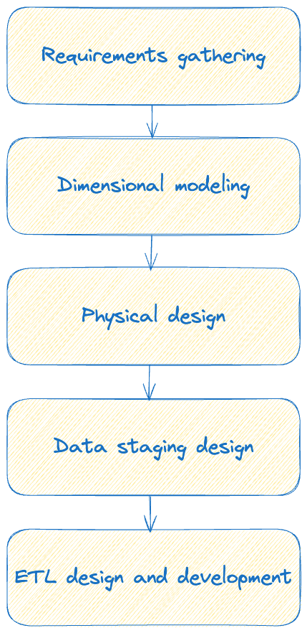
Data Warehouse Design Process
Requirements gathering
Dimensional modeling
Physical design
Data staging design
ETL design and development
DATATECH LABS.

Slide 29
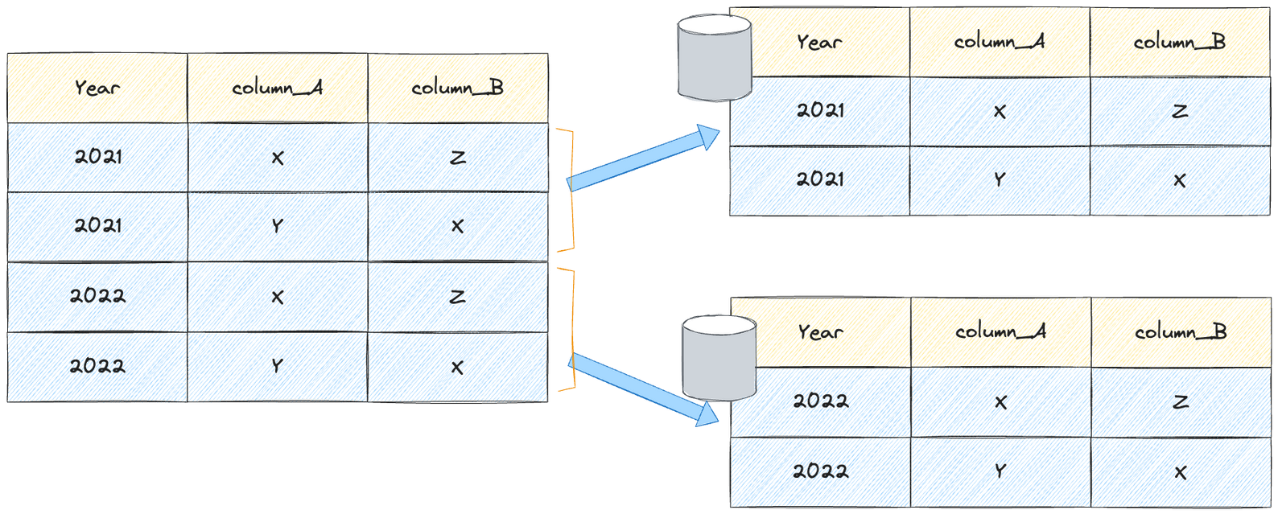
Data Warehouse Performance Tuning
Indexing strategies
Partitioning
Materialized views
Query optimization
Partitioning
DATATECH LABS.

Slide 30
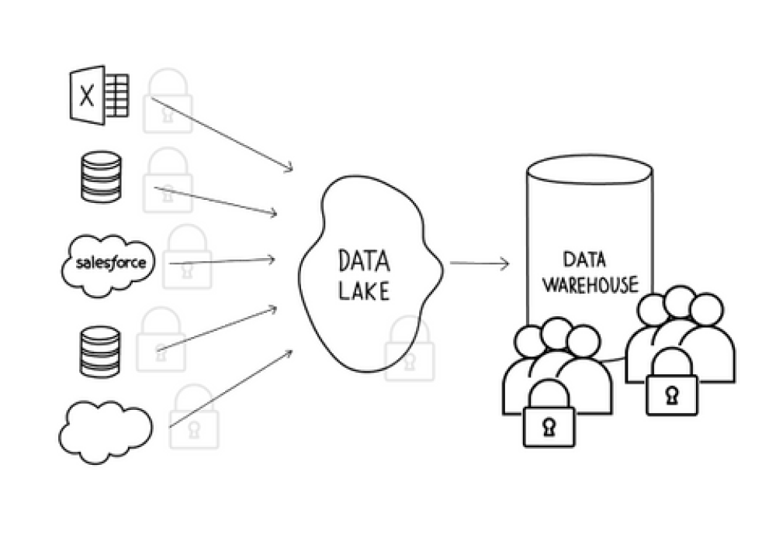
Security in Data Warehousing
Access control
Data encryption
Auditing and monitoring
Compliance considerations (e.g., GDPR, HIPAA)
DATATECH LABS.

Slide 31
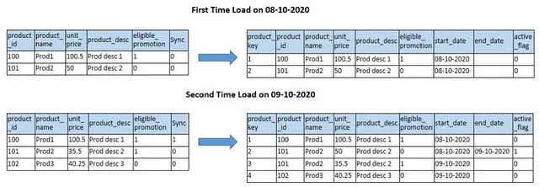
Slowly Changing Dimensions (SCDs)
Type 1: Overwrite
Type 2: Add new row
Type 3: Add new attribute
Type 4: Use history table
Type 6: Hybrid approach
DATATECH LABS.

Slide 32

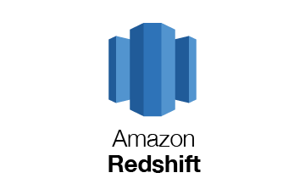
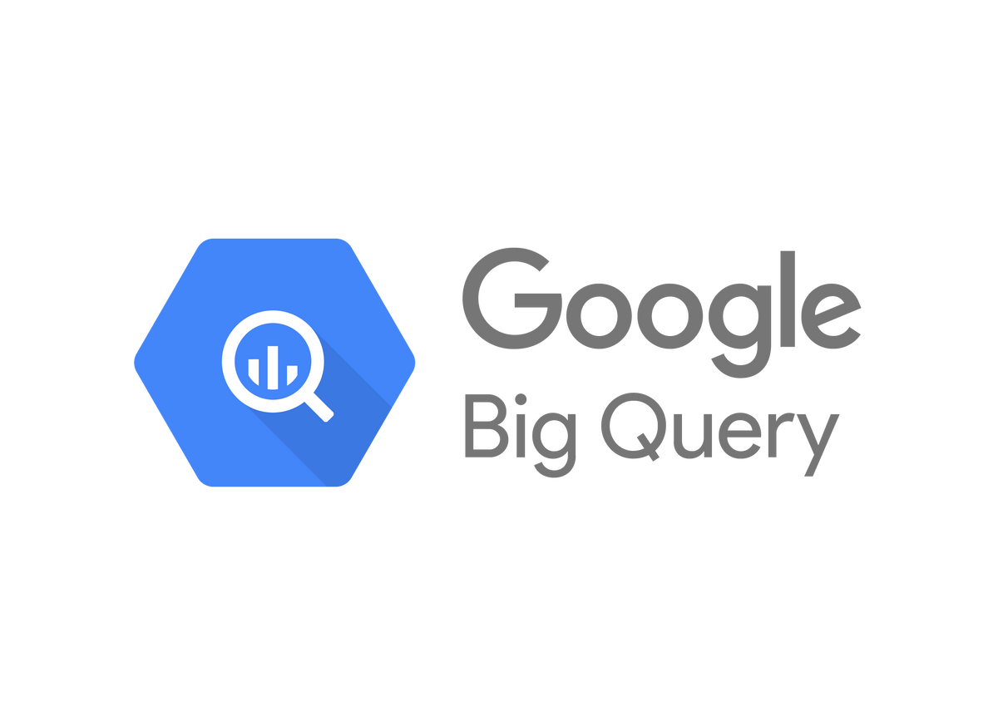

Popular Data Warehouse Technologies
Modern Data Warehouses:
Amazon Redshift
Google BigQuery
Apache Hive
Snowflake
Azure Synapse Analytics
Teradata
Modern Data Warehouse Trends
Cloud-based data warehousing
Real-time data warehousing
Big data integration
Machine learning integration
DATATECH LABS.

Slide 33
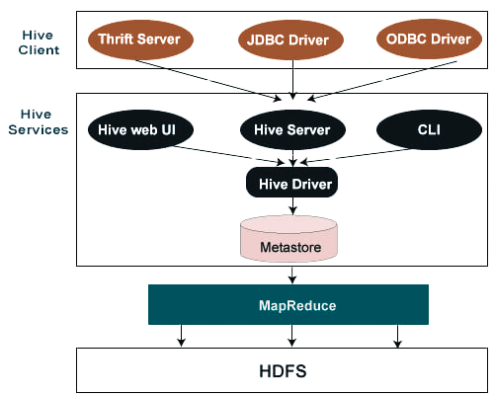
Big Data Warehousing: Apache Hive
Overview:
Apache Hive is a data warehousing infrastructure built on top of Hadoop.
It provides a query language called HiveQL, similar to SQL, for querying and managing large datasets residing in distributed storage.
Key Features:
Data Warehouse Infrastructure: Hive is designed for managing and querying large datasets stored in Hadoop HDFS.
HiveQL: A SQL-like language for querying data, making it accessible to users familiar with SQL.
Scalability: Supports massive data storage and processing needs.
DATATECH LABS.

Slide 34
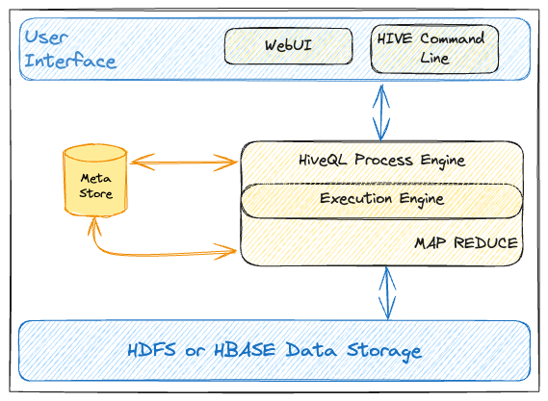
How Apache Hive Works
Architecture:
MetaStore: Stores metadata about tables, columns, partitions, and more.
Driver: Receives queries, compiles them, and manages their execution.
Compiler: Compiles HiveQL into MapReduce or Tez jobs.
Execution Engine: Executes the jobs on Hadoop, typically using MapReduce or Tez.
Workflow:
User submits a HiveQL query.
The query is compiled into a series of MapReduce jobs.
Jobs are executed on Hadoop, and results are returned to the user.
DATATECH LABS.

Slide 35
Hands-on:
Data Warehousing: Apache Hive
DATATECH LABS.

Slide 36
Q&A and Discussion
DATATECH LABS.

Slide 37
Modern Data Architectures
DATATECH LABS.

Slide 38
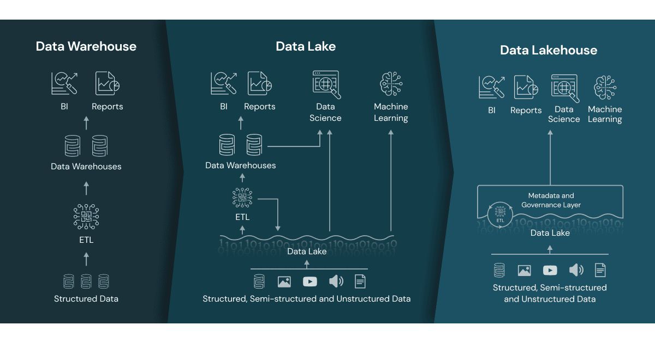
Data Lakehouse Concept
Definition: A new data management paradigm that combines the best elements of data lakes and data warehouses
Key features:
ACID transactions
Schema enforcement
BI support
Decoupled storage and
compute
DATATECH LABS.

Slide 39
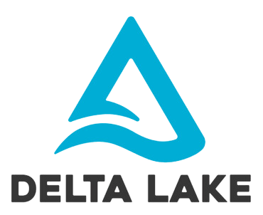
Delta Lake
Open-source storage layer for data lakes that gives the ability for CRUD operations in Data Lakes.
Key features:
ACID transactions
Scalable metadata handling
Time travel (data versioning)
Schema enforcement and evolution
Audit history
DATATECH LABS.

Slide 40
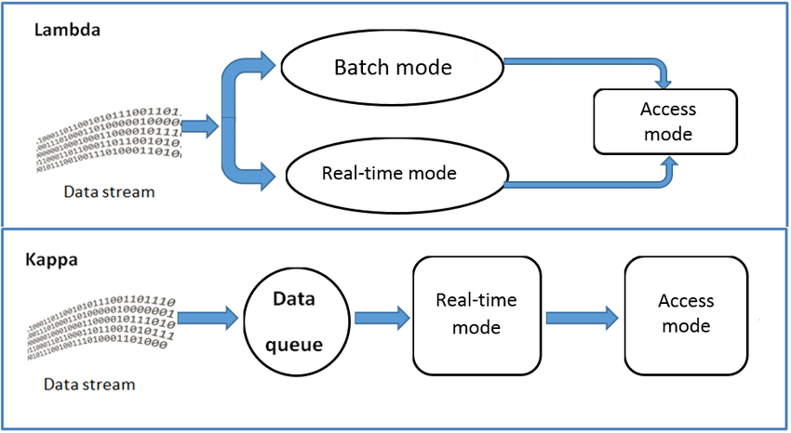
Modern Data Architecture Patterns
Lambda Architecture:
Batch layer
Speed layer
Serving layer
Kappa Architecture:
Stream processing as the core
Reprocessing capabilities
Unified Architecture (Data Lakehouse)
DATATECH LABS.

Slide 41
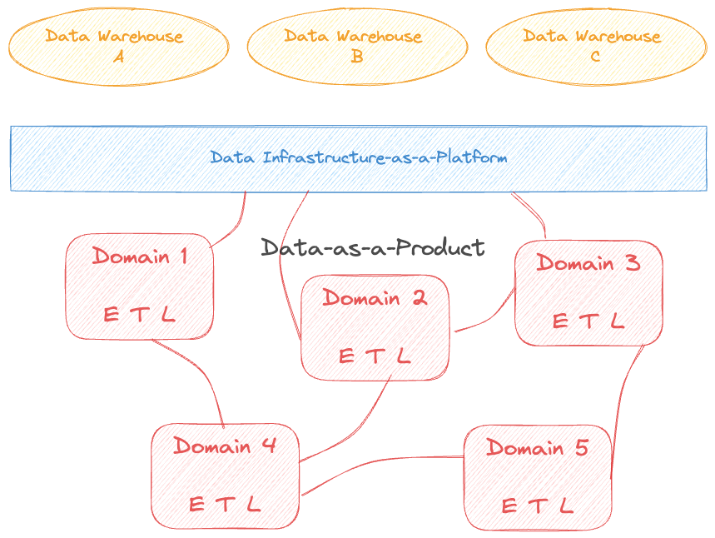
Data Mesh Architecture
Definition: A decentralized socio-technical approach to data management
Key principles:
Domain-oriented decentralized data ownership
Data as a product
Self-serve data infrastructure
Federated computational governance
Discussion: the trade-offs between
centralized (e.g., data lake) and
decentralized (e.g., data mesh)
approaches to data architecture.
DATATECH LABS.

Slide 42

Implementing Data Quality in Modern Architectures
Data profiling
Data validation rules
Anomaly detection
Data quality scorecards
Automated data cleansing
DATATECH LABS.

Slide 43

Future Trends in Data Architectures
AI-driven data management
Edge computing and IoT integration
Blockchain for data integrity
Quantum computing for data processing
DATATECH LABS.

Slide 44
Q&A and Discussion
DATATECH LABS.

Slide 45

MEET OUR TEAM
Omar AlSaghier
Sr. Data Engineer
DATATECH LABS.

Slide 46







DATATECH LABS.
THANK YOU
OUR CONTACT
DataTechLabs
datatechlabs.ai@gmail.com
datatechlabs.ai
Amman, Jordan

